Slide 1


Slide 2
Account Calculator Objective
As an Accountant I want to add two numbers so that I can see what the total is.
As an Accountant I want to subtract two numbers so that I can see what the difference between them is.
As an Accountant I want to divide two numbers so that I can know the quotient.
As an Accountant I want to multiply two numbers so that I can see what their product is.
As an Accountant I want to toggle the sign of numbers so that I can reverse them at will.
As an Accountant I want to delete a wrongly entered digit so that I can correct the number to input.
As an Accountant, I want to store a number so that I can use it later.
As an Accountant I want to reset the calculator so that I can start fresh.
As an Accountant, I want to store operations so that I can recall them to see the steps that resulted in the final answer.

Slide 3
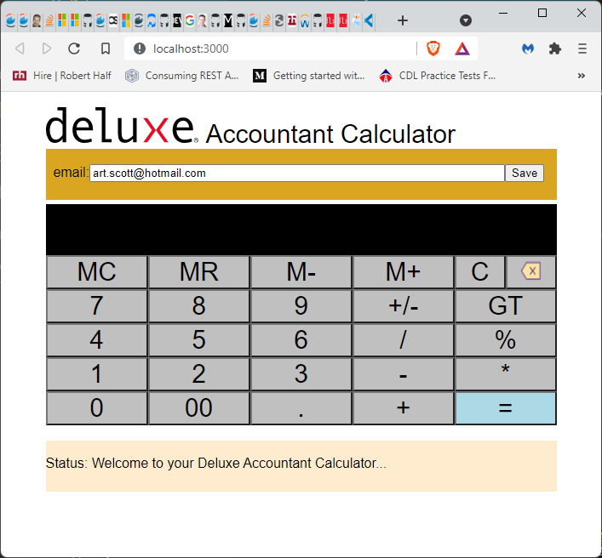

Slide 5
Function Keys
MC = Master Clear. Resets Memory; Grand Total; and Results
MR = Memory Recall. Displays what is stored in memory
M- = Memory Clear. Sets memory value to zero
M+ = Memory Add. Adds result value to memory
C = Clear the result display
– = Clear the last key stroke

Slide 6
Calculator Entries
Keys 0 to 9 : integer values keys
00 : add two zeros
+/- : Change the sign
GT : Grand Total, displays the total values until the next MC has been selected
/ : divide
% : convert to percentage
- : subtract
* : multiple
+ : addition
= : calculate result

Slide 7
Status and Error message
Display welcome and status messages
Display any error details when performing calculations

Slide 8
Save to database by Email - future
Will allow the Accountant to save any calculations to the Calculator database
Will allow the Account to load any historical calculations from the Calculator database
This functionality will call the Deluxe.Calculator.Api service
The service has been created
The database has been created
Includes Account Calculator store table and an Error tracking table
Phase 2 – hook up the UI to the API

Slide 9
Deluxe.Calculator.API
Calculator
React – using node and npm (latest versions)
Visual Studio Code
.NET Core 5.0 WebApi
.NET Core 5.0 xUnit
Documentation
GIT Repository
Current practices and standards
Security practices and standards
SQL Injection; IP Address whitelist, etc.
GIT practices and standards
Branches; PR; etc.
CI with Docker and Docker Compose
Visual Studio 2019

